Slide 1


Krushanthan Ragunathan
June 18th, 2024

Slide 2

Outline
Executive Summary
Introduction
Methodology
Results
Conclusion
Appendix

Slide 3
Executive Summary
Use machine learning models to predict whether the first stage of a Falcon 9 rocket will successfully land based on data collected from previous launches.
Summary of methodologies
Data Collection using SpaceX API
Data collection using a web scraping approach
Data wrangling
Expletory Data Analysis with SQL commands
Data visualization using Dash
Interactive data visualization analysis using Folium
Prediction using machine learning models and algorithms
Summary of all results
Results from expletory data analysis and interactive maps
Outputs derived from the machine learning models and key parameters
Performance comparison results of the machine learning models

Slide 4
Introduction
Project background and context
SpaceX is promising to revolutionize the aerospace industry with low-cost launches. Falcon 9’s stage rocket can land back on Earth successfully and is ready for the next mission. This approach will significantly reduce the cost for every launch mission.
Problems you want to find answers
What attributes play a crucial role in a successful landing?
What are the external operating conditions determining a successful landing?

Slide 5

Section 1

Slide 6
Methodology
Executive Summary
Data collection methodology:
Data was collected using SpaceX API and Web Scrapping methods.
Perform data wrangling
Outcome values were summarized and converted to True/ False indicators.
Perform exploratory data analysis (EDA) using visualization and SQL
Perform interactive visual analytics using Folium and Plotly Dash
Perform predictive analysis using classification models

Slide 7
Data Collection
Methods explained below were followed during the Data Collection
Space X API was invoked first to retrieve the data
Using the json() function, the API response was formatted and converted to a Data Frame with .json_normalize.
Using the web scraping method, Falcon 9 launch records were acquired from Wikipedia using BeautifulSoap.
Wikipedia data then converted to Data Frame for further analysis.

Slide 8
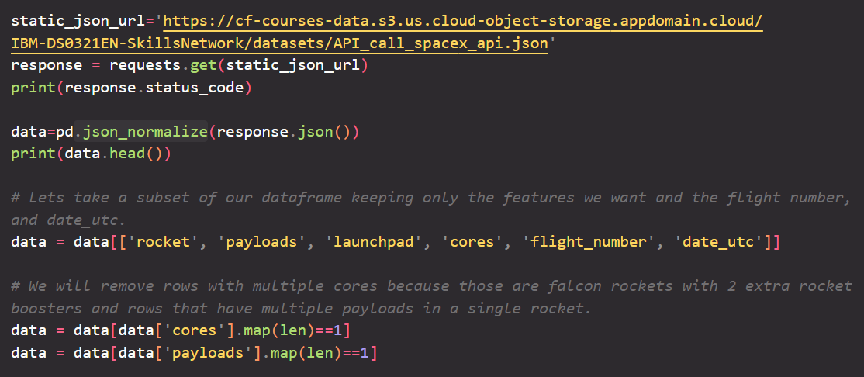
Data Collection – SpaceX API
SpaceX API calls notebook (Please click the link view the Notebook)

Slide 9
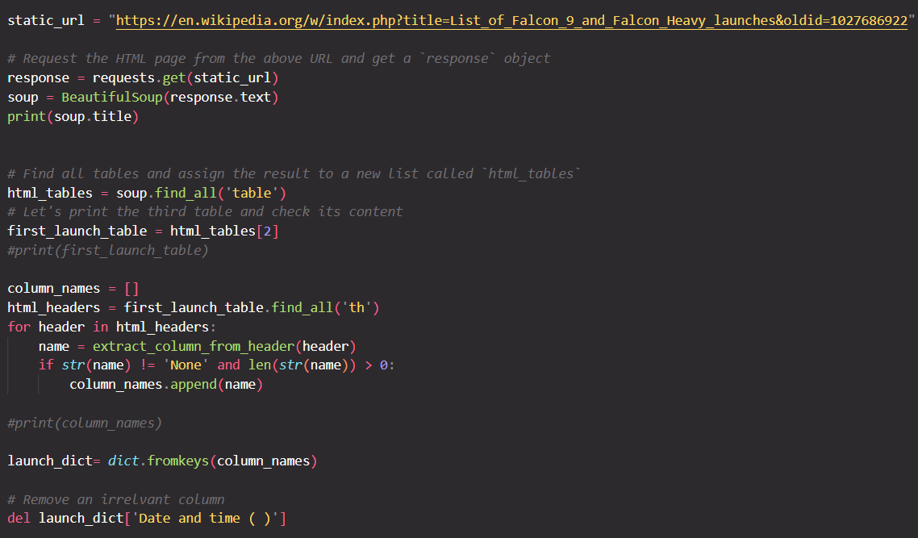
Data Collection - Scraping
Web scraping notebook (Please click the link to view the Notebook)

Slide 10
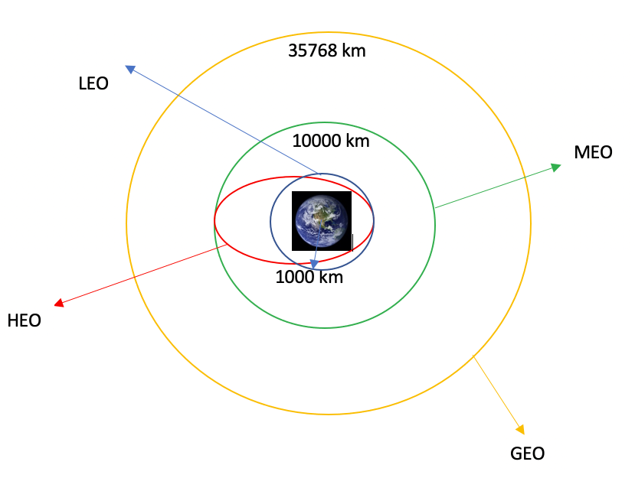
Data Wrangling
Calculated the number of launches at each site and the number and occurrence.
Calculated the number and occurrence of mission outcomes of the orbits.
Created landing outcome label from the outcome column and exported the results to a CSV file.
Data wrangling related notebook

Slide 11
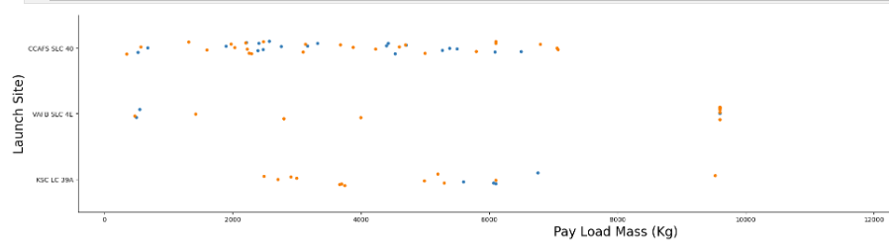
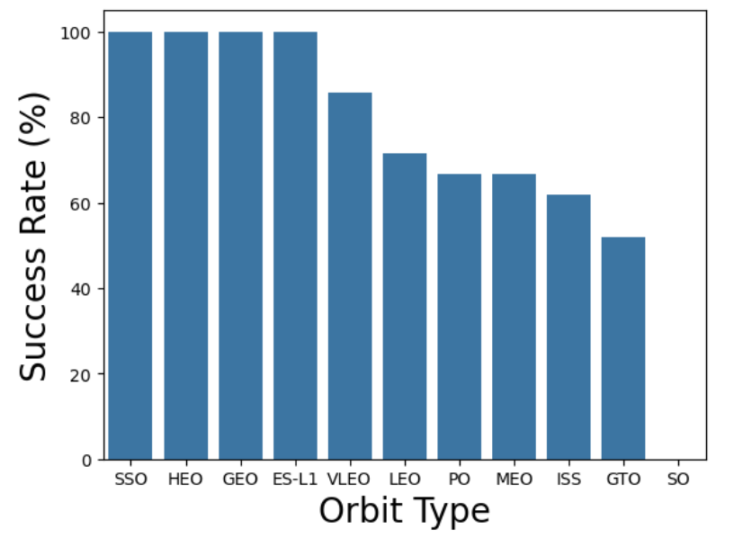
EDA with Data Visualization
Explored the data for the given attributes.
Flight Number vs Launch Site
Pay Load vs Launch Site
Orbit Type vs Success Rate
Flight Number vs Orbit Type
Pay Load vs Orbit Type
Launch Year vs Success Rate
Data visualization notebook

Slide 12
EDA with SQL
Performed the queries below after successfully loading the CSV file into a database.
Names of the unique launch sites
Launch Site names begin with “CCA.”
Total payload mass carried by boosters launched by NASA (CRS)
Average payload mass carried by booster version F9 v1.1
Total number of successful and failed mission outcomes
Failed landing outcomes in drone ship, their booster version, and launch site names
EDA with SQL notebook

Slide 13
Build an Interactive Map with Folium
All launch sites have been marked with map objects such as markers and circles to indicate the success or failure of the launch outcome.
We've classified the launch outcomes into two categories, Class=1 for Success and 0 for Failure. This classification is visually represented on the interactive map with color indicators, green for Success and red for Failure, making it easy to interpret the data.
Calculated distance between the launch sites and their proximities, such as nearest coastal lines, railroad, city, and highways.
Interactive map with the Folium map (Please refer to the screenshot folder to review map outcome)

Slide 14
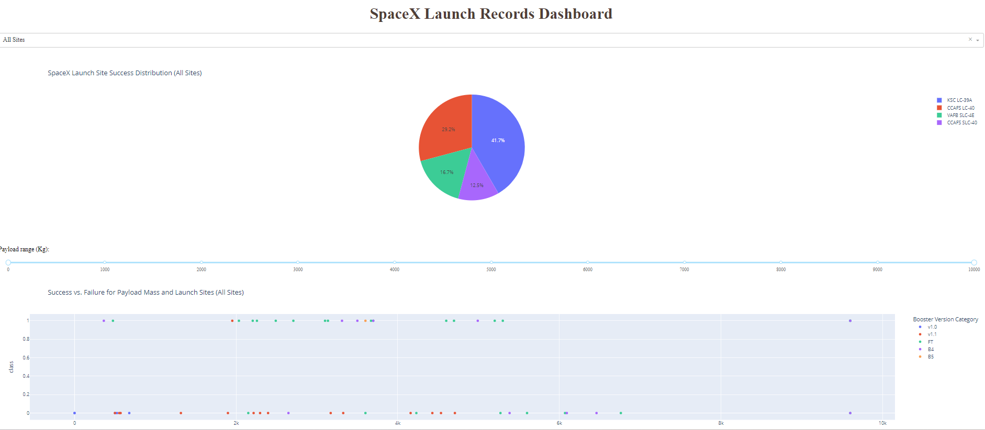
Build a Dashboard with Plotly Dash
The mentioned plots were created using Plotly Dash.
Pie Chart – to show the total launch by sites and success/ failures in selected sites.
Scatter Plot – to show the relationship between Outcome and Payload Mass (kg) for different booster versions.
Plotly Dash lab

Slide 15
Predictive Analysis (Classification)
Summary of the model development used to predict the success rate of the first stage launch.
Create a NumPy array from the column Class in data.
Data standardization.
Train and Test data split.
Identify the best Hyperparameter for Logistic Regression, SVM, Decision Tree, and KNN classifiers using GridSearchCV.
Calculate the accuracy of each model to compare the model performance.
Predictive Analysis Notebook

Slide 16
Results
Exploratory data analysis results
Interactive analytics demo in screenshots
Predictive analysis results

Slide 17

Section 2

Slide 18
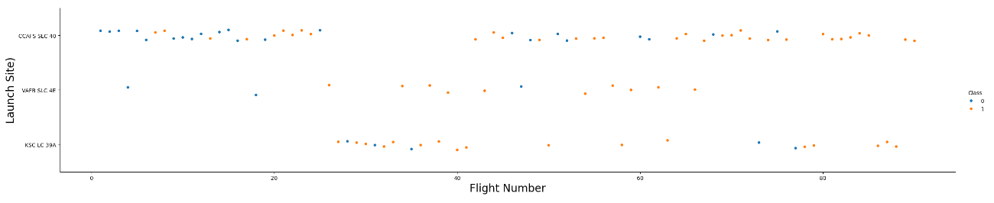
Flight Number vs. Launch Site
With time (assuming flight number increases over time), each site's success rate has increased.
Launch Site CCAFS SLC 40 plays a significant role in the mission data.

Slide 19
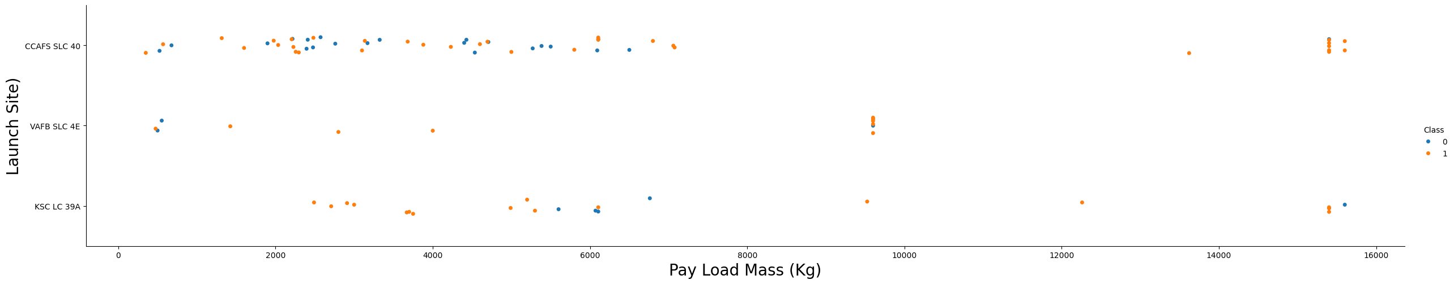
Payload vs. Launch Site
The majority of the rockets launched had a payload of less than 7500kg.
Out of 7 missions carried out with a payload between 7500-15750kg, six were successful.

Slide 20
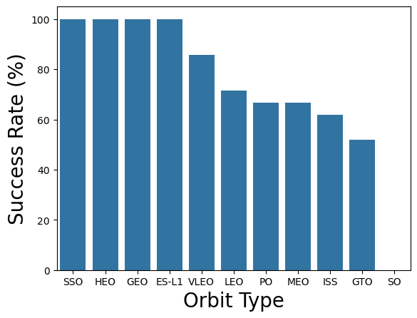
Success Rate vs. Orbit Type
From the plot results, we can say that SSO, HEO, GEO, and ES-L1 had the most successful missions.
Adding the number of missions for each Orbit will give a better understanding of the success rate for comparison.

Slide 21
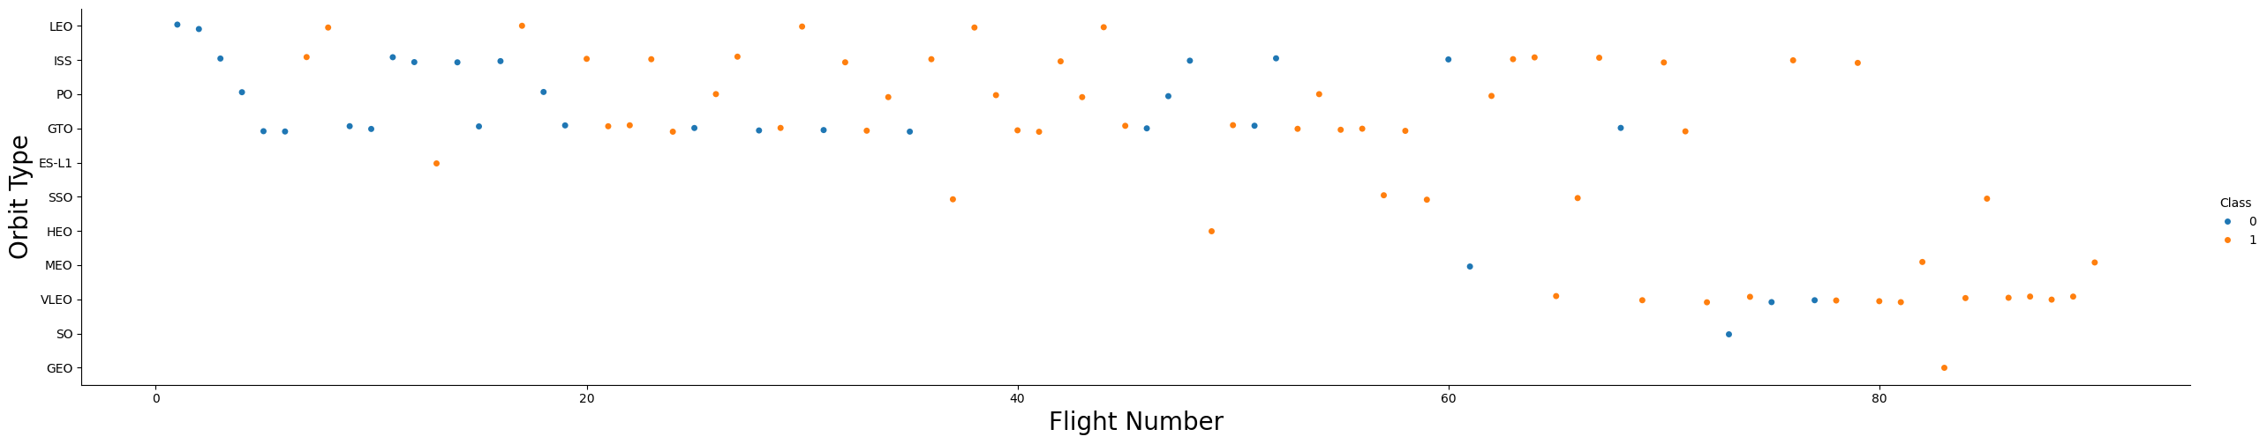
Flight Number vs. Orbit Type
As pointed out in the previous slide, Orbits has a higher success rate but fewer launches than others.
There is no significant relationship between Orbit Type and Flight Number.

Slide 22
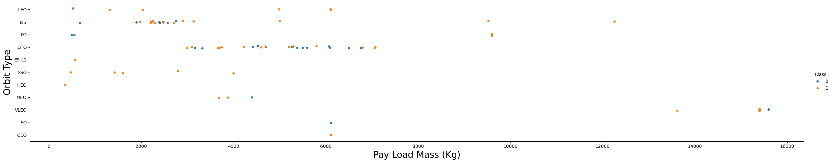
Payload vs. Orbit Type
With heavy payloads, the success rate is high for PO, LEO, and ISS.
However, for GTO, we cannot distinguish this well as both positive landing rate and negative landing(unsuccessful mission) are there here.

Slide 23
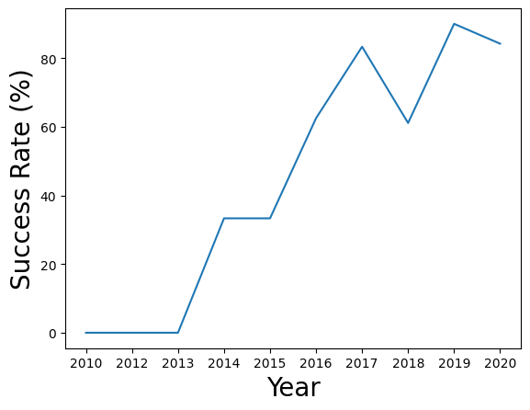
Launch Success Yearly Trend
Success rate has continuously shown an upward trend since 2013.

Slide 24
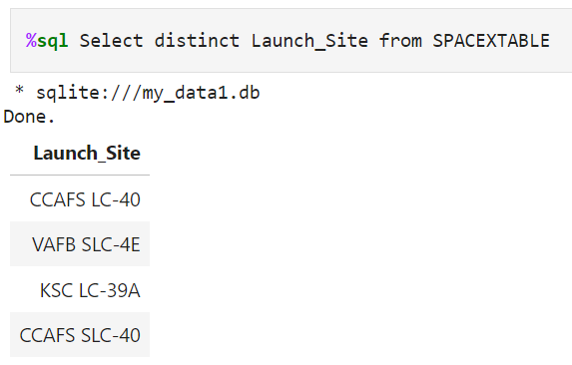
All Launch Site Names
The DISTINCT keyword in the query brings the unique launch sites from SpaceX Data.
Four unique launch sites were found.

Slide 25
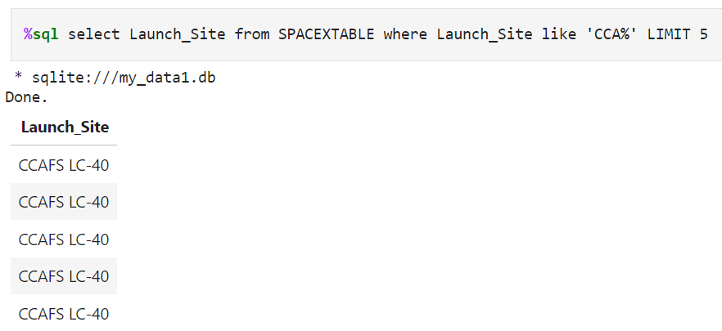
Launch Site Names Begin with 'CCA'
“LIKE ‘CCA%’” in the Where clause will list down the Launch Sites name starting with “CCA.”

Slide 26
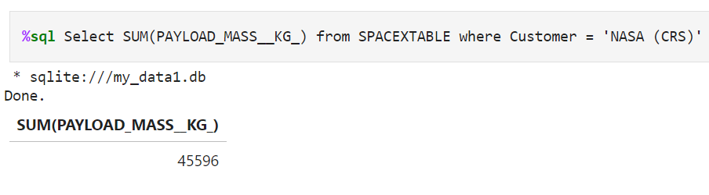
Total Payload Mass
SUM keyword will calculate the total of the PAYLOAD_MASS_KG column.

Slide 27
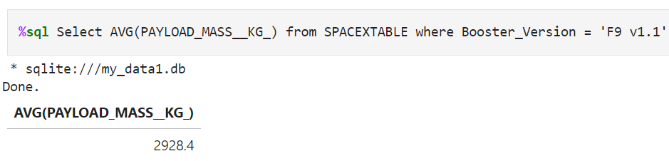
Average Payload Mass by F9 v1.1
AVG keyword is used here to calculate the average of the PAYLOAD_MASS_KG column.

Slide 28
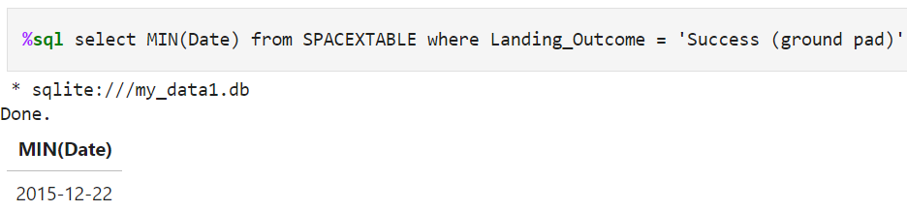
First Successful Ground Landing Date
The MIN keyword finds the least value from the Date column.

Slide 29
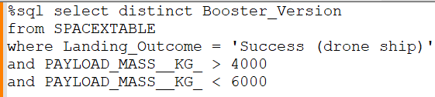
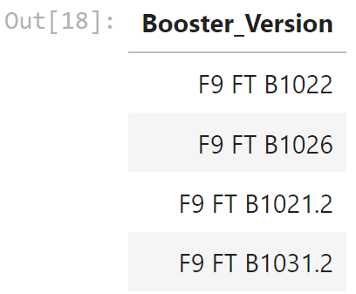
Successful Drone Ship Landing with Payload between 4000 and 6000
The condition used in the WHERE clause will filter the successful landings on drone ships. Then, the AND condition is used to find the successful landings with a payload mass greater than 4000kg but less than 6000kg.

Slide 30
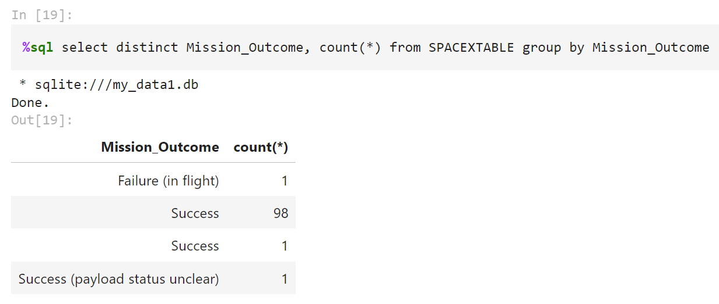
Total Number of Successful and Failure Mission Outcomes
There are multiple keywords used here.
Distinct – find the unique Mission Outcomes.
Count – total number of each unique mission outcome.
Group by-group, the results are based on the mission outcome value.

Slide 31
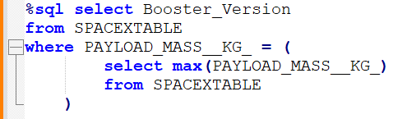
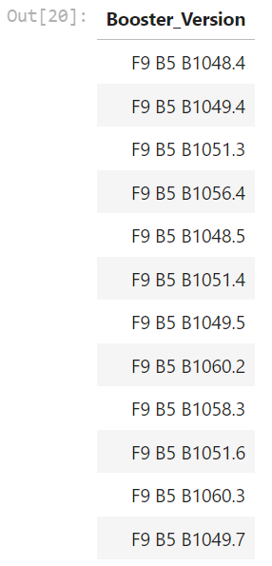
Boosters Carried Maximum Payload
The MAX keyword is used to find the largest value available for the Payload column.

Slide 32
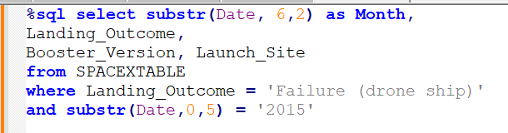
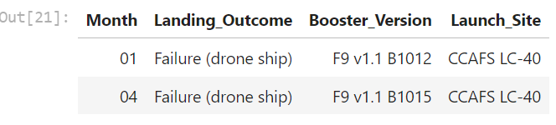
2015 Launch Records
Substr function is used to pick the Month/ Year from the full date value.

Slide 33
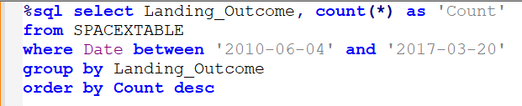
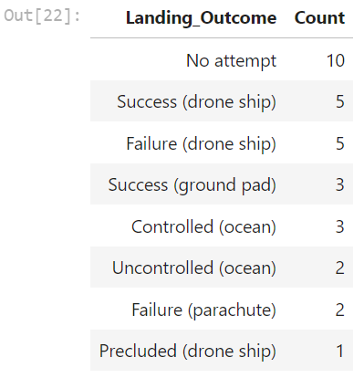
Rank Landing Outcomes Between 2010-06-04 and 2017-03-20
Keyword DESC is used to present the results in descending order.

Slide 34

Section 3

Slide 35
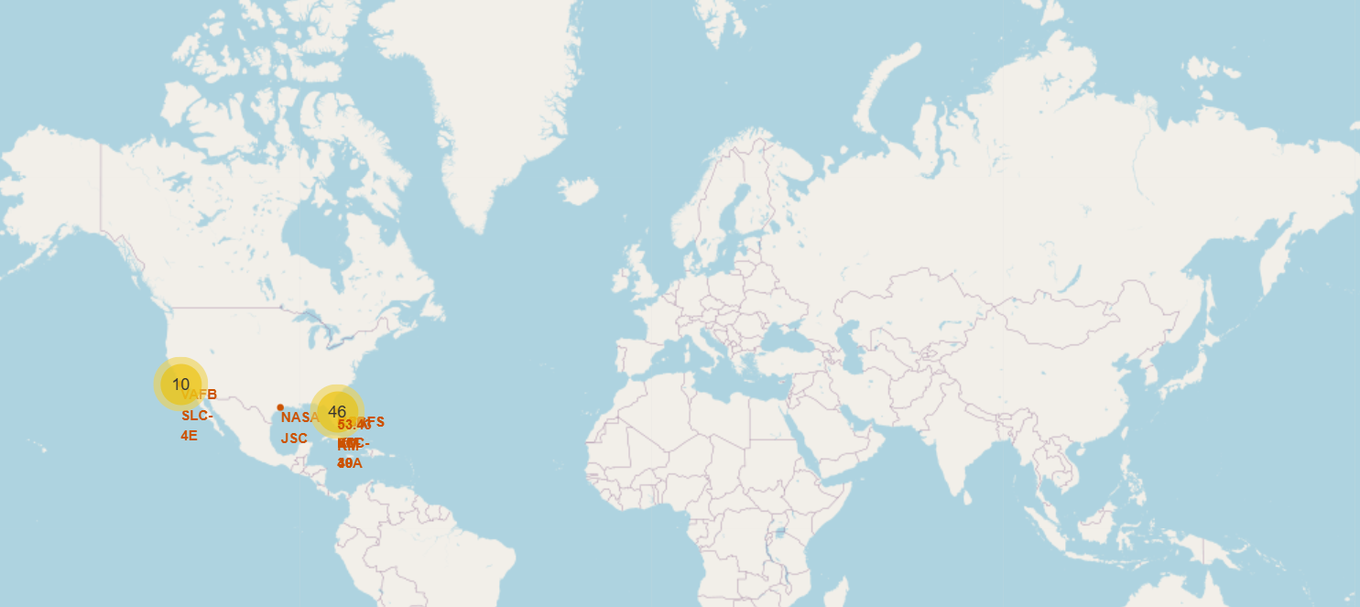
All Launch Sites
All the launch sites are situated only in the United States.
All of them are strategically constructed near the coastal lines in CA and FL.

Slide 36
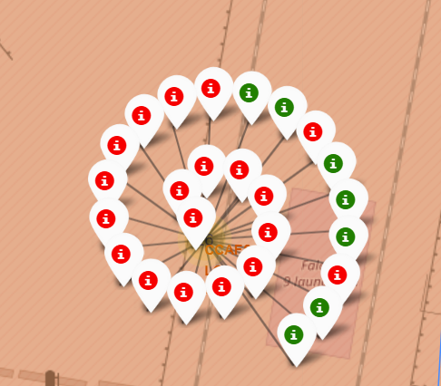
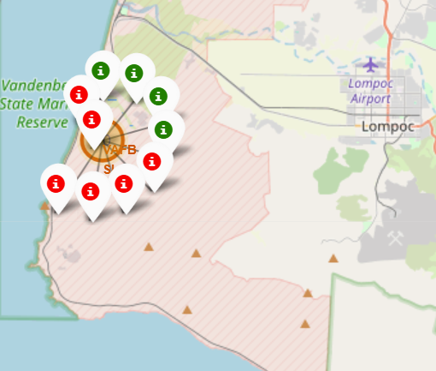
Success/ Failure Markers
The above map indicates successes and failures at a launch site with color-coded markers (Green-success, red-failure).

Slide 37
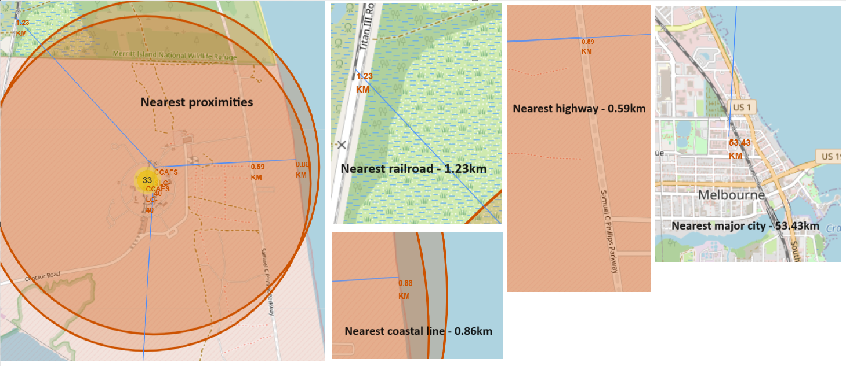
Launch Sites with Proximities
The launch site is very near landmarks such as the railroad and highways, ensuring easy access to supplies.
Meanwhile, the launch site is far from the nearest major city but near the coastal line to avoid disasters.

Slide 38

Section 4

Slide 39
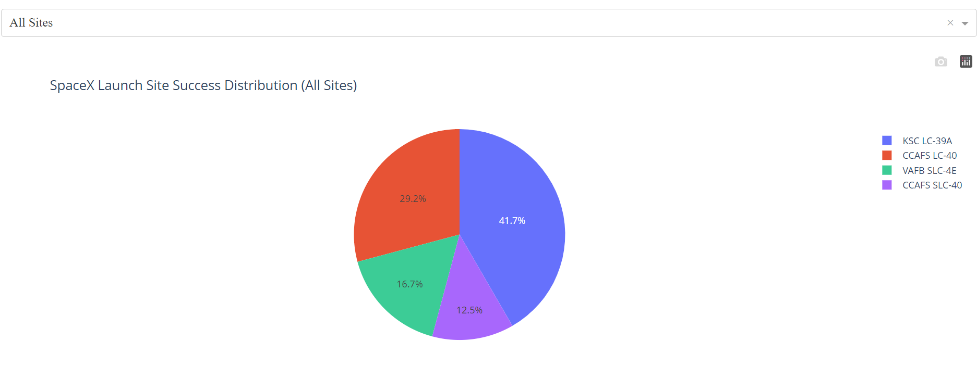
Successful Missions for All Sites
Launch Site KSC LC-39A has the highest success rate of missions, followed by CCAFS LC-40.

Slide 40
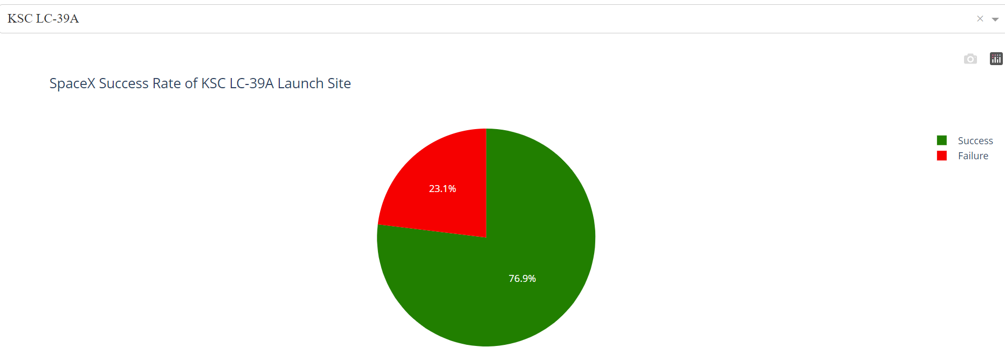
Launch Site drill down
Most successful Launch Site KSC LC-39A has 76.9% success rate.

Slide 41
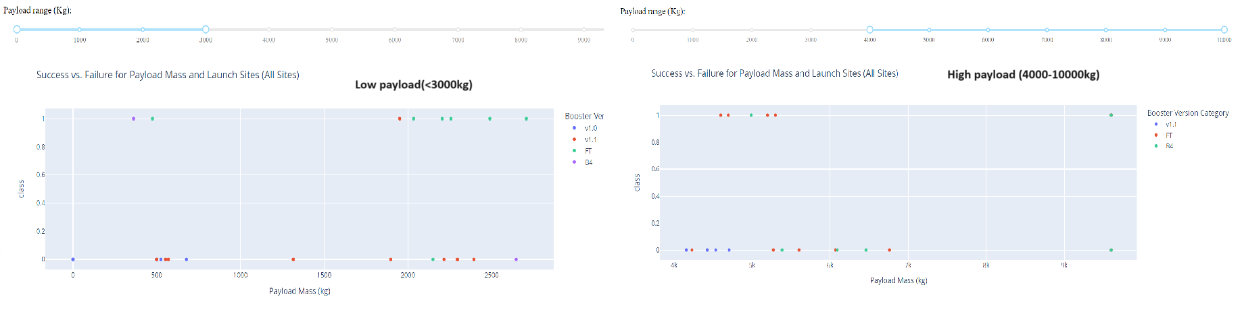
Payload vs Launch Outcome Analysis
Payload < 3000kg has a higher success rate than higher payload missions.
Based on the pattern, low to medium amounts of payload yielded successful missions.
Thus, prove that, as we have seen in slide #19, payload < 7500kg has a high success rate.

Slide 42

Section 5

Slide 43
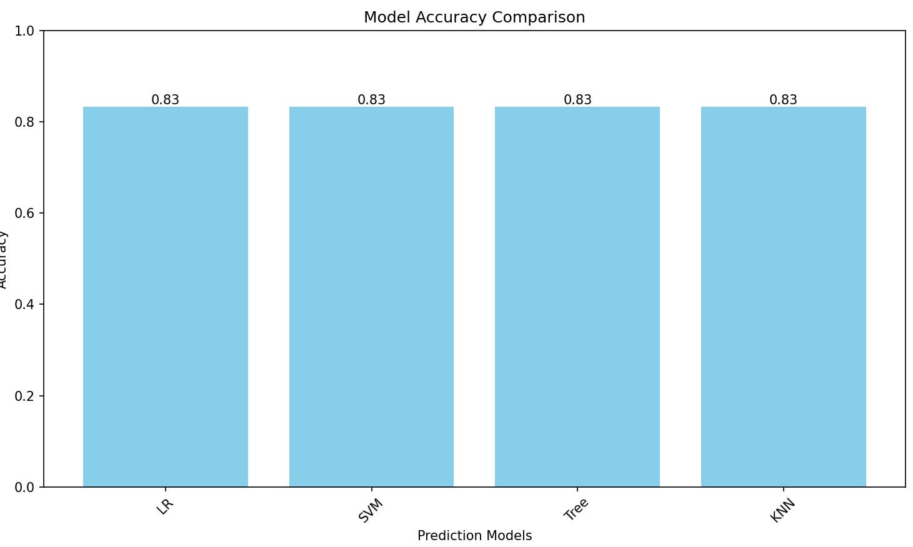
Classification Accuracy
All four of the models have achieved the same accuracy level.

Slide 44
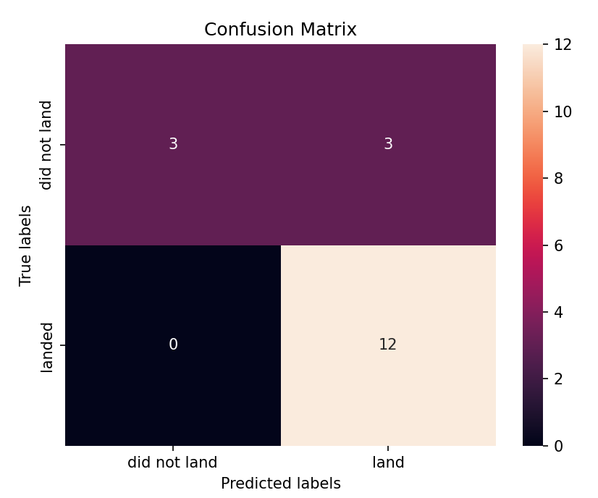
Confusion Matrix
All four models have shown the same pattern.
True Positive – Model correctly predicted 12 times
False Positive – The model incorrectly predicted three times when it was not.
True Negative – The model correctly predicted three unsuccessful landings.
False Negative – The model incorrectly predicted unsuccessful landings 0 times when they were successful.

Slide 45
Conclusions
All models have shown the same level of accuracy 83 .33%, from our testing.
Based on the confusion matrix, all four models have the highest rating for predicting successful landings (12 true positives).
Fine-tuning is needed to address the false positive outcome.
Our Machine Learning models can be deployed to predict the first stage of the landing and predict the cost for the launch mission.

Slide 46
Appendix
All the Python code, Notebooks, Data Sets and Screenshots can be found here: https://github.com/rkrushanthan/IBM-Data-Science-Capstone

Slide 47


